Slide 1
APA Citation and Format
Library
Library@HarrisburgU.edu
(717) 901-5188

Slide 2
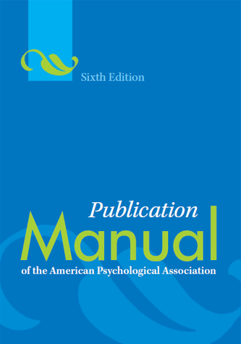
The Ultimate Resource
Publication Manual of the American Psychological Association (6th ed.)

Slide 3
Additional Resources
HU APA Guide
Purdue Online Writing Lab (OWL)
Citation Generators*
KnightCite
BibMe
Citefast
*Always double check citations from a generator – you are still responsible that your citations are correct!!
Notes:
Here are some terrific, free, online tools that could help you.
The first is the library’s APA guide. Use this guide to find answers to some of the most common APA questions.
The Purdue Online Writing Lab is a very in-depth source that has almost every kind of example you can think of for citations.
Valencia College has really good citation examples of online resources like blogs, YouTube videos, and even Facebook and Twitter posts. Did you know you have to cite a Facebook post if you use it? You do!
Here are three free online citation generators that seem to be OK. However, you still always have to double check the citations! You are still responsible to turn in your assignment with correct citations, even if a citation generator didn’t generate it correctly for you. But we’ll come back to this topic a little later.

Slide 4



Additional Resources
Librarians!
David Runyon,
University Librarian
Emily Reed,
Resources Librarian
Calida Barboza,
Resources Librarian
Notes:
Librarians are another terrific resource easily available to you! Your professors can also help you as you navigate the confusing waters of APA citation.

Slide 5
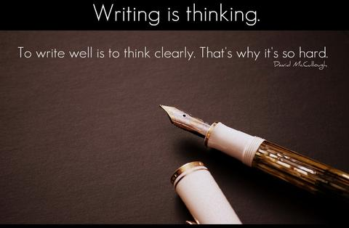
Additional Resources
Writing Center
Reserve an appointment:
Tutoring@HarrisburgU.edu
Notes:
The Writing Center tutors are also available to help you integrate your sources with proper citation techniques.

Slide 6

Where to Cite
In the text of your document
In the References list at the end of your document
Notes:
There are 2 places you must cite any source you use. The first is in the text of your assignment. This is when you write a sentence that might say something like, “According to so-and-so . . .” This is the first place you must cite.
The second is in your Reference list at the very end of your assignment. This is a full citation of the source.

Slide 7
You MUST cite:
Direct quotes
Paraphrases
Images/video clips
Statistics, Tables, Graphs, etc.
Include:
(Author’s last name, Year, page or paragraph number)
Notes:
Let’s look at citing in the body of your assignment. You must cite any direct quotes you might use, when you paraphrase any idea that is not your own original thought, any images or video clips you did not personally create, and any statistics or tables or graphs that someone else created.
When you cite in the body of the assignment, this is an abbreviated citation. You only include the author’s last name, the year it was published, and the page number you found it on.

Slide 8
Examples of Print Sources
Quote:
“Citing your sources is vital to avoid plagiarism and make your paper more credible” (Jones, 2015, p. 105).
Quote:
According to Jones (2015), “Citing your sources is vital to avoid plagiarism and make your paper more credible” (pp. 105-106).
Notes:
Let’s look at some examples of citing a book or journal article. Here we have a direct quotation which always uses quotation marks. We make sure to include in parentheses at the end the author’s last name, the year published, and the page number indicated with a p.
The second example is again a direct quote, but here we’ve broken up the citation, which is perfectly fine as long as all the elements are there. We see “Jones (2015)” is at the beginning of the sentence, and the page numbers are at the end. Notice that when there’s more than one page being quoted, you use pp.

Slide 9
Examples of Web Sources
Quote:
According to Jones (2015), “Citing your sources is vital to avoid plagiarism and make your paper more credible” (para. 10).
Paraphrase:
Not only are you avoiding plagiarism by citing your sources, but it also makes your research more credible (Jones, 2015, para. 10-11).
Notes:
Here are some examples of citing webpages. The first example is a direct quote. Because this is a web resource, there probably won’t be page numbers. When there are no page numbers, use paragraph numbers (yes, you have to manually count).
The second example here is a paraphrase. You still have to cite whenever you paraphrase someone else’s idea to support your own argument. If there are multiple paragraphs being referenced, use para.

Slide 10
Knowledge Check
Which of the following is an incorrect in-text citation?
According to Smith (2015), “APA is a preferred citation format for academics” (p. 2).
According to Smith (2015), “APA is a preferred citation format for academics” (pp. 2).
Notes:
“Let’s check to see if you can identify which of these is incorrect.”
Have students guess and say why they think it’s incorrect.

Slide 11
Knowledge Check
Is this a correct in-text citation?
“APA is a preferred citation format for academics” (Smith, 2015, paras. 3-4).
NO!
Notes:
“Is this citation correct? Why?”

Slide 12
Book Reference
Author's last name, initials. (year of publication). Title of book: With only capitalization of first word of title and subtitle and any proper nouns. Place of Publication: Publisher.
Notes:
For your Reference list, you will use the full citation of each source. Let’s look at the general format of a book citation.

Slide 13
Book Reference Example
King, M. L., Jr. (2010). Stride toward freedom: The Montgomery story. Boston, MA: Beacon Press.
Notes:
Here’s an example of a book citation. Notice that not every word is capitalized in the title – only the first word, the first word in the subtitle, and “Montgomery” because it’s a proper noun.

Slide 14
Knowledge Check
(2011).
Gauld, M.
Rowman & Littlefield Education.
New York, NY:
College success guaranteed: 5 rules to make it happen.
Notes:
“Let’s work on putting together a citation in the right order.”

Slide 15
Knowledge Check
Gauld, M.
(2011).
Rowman & Littlefield Education.
New York, NY:
College success guaranteed: 5 rules to make it happen.
Notes:
“Author’s name comes first.”

Slide 16
Knowledge Check
Gauld, M.
(2011).
Rowman & Littlefield Education.
New York, NY:
College success guaranteed: 5 rules to make it happen.
Notes:
“Date comes next.”

Slide 17
Knowledge Check
Gauld, M.
(2011).
College success guaranteed: 5 rules to make it happen.
Rowman & Littlefield Education.
New York, NY:
Notes:
“Then the title.”

Slide 18
Knowledge Check
Gauld, M.
(2011).
College success guaranteed: 5 rules to make it happen.
New York, NY:
Rowman & Littlefield Education.
Notes:
“Next is the place of publication.”

Slide 19
Knowledge Check
Gauld, M.
(2011).
College success guaranteed: 5 rules to make it happen.
New York, NY:
Rowman & Littlefield Education.
Notes:
“And last is the publisher’s name. Any questions?”

Slide 20
Journal Reference
Author's last name, initials. (year). Article title. Journal Title, volume#(issue#), pages. doi
Notes:
Now let’s look at the general format for a journal article. A DOI is a digital object identifier. It’s a number that is permanently assigned to that particular article. The DOI helps your audience find the source you used. Not all journal articles have a DOI. If it doesn’t then use a URL. But URLs are not as good as a DOI because they can be broken over time, and a DOI will never change.

Slide 21
Journal Reference Example
Oliver, A., & Khanna, M. (2017). Demand for biomass to meet renewable energy targets in the United States: Implications for land use. GCB Bioenergy, 9(9), 1476-1488. doi:10.1111/gcbb.12437
Notes:
Here’s an example of a journal article citation. Notice the capitalization and italicization both for the article title and journal title. We also have a DOI here (notice that it’s a combination of numbers and letters).

Slide 22
Knowledge Check
1-21.
Sensors,
doi:10.3390/s17081866
Glucose sensing for diabetes monitoring: Recent developments.
Bruen, D., Delaney, C., Florea, L., & Diamond, D.
17(8),
(2017).
Notes:
“Let’s try putting together a journal citation now. What comes first?”

Slide 23
Knowledge Check
Bruen, D., Delaney, C., Florea, L., & Diamond, D.
1-21.
Sensors,
doi:10.3390/s17081866
Glucose sensing for diabetes monitoring: Recent developments.
17(8),
(2017).
Notes:
“The author’s name! Next?”

Slide 24
Knowledge Check
Bruen, D., Delaney, C., Florea, L., & Diamond, D.
(2017).
1-21.
Sensors,
doi:10.3390/s17081866
Glucose sensing for diabetes monitoring: Recent developments.
17(8),
Notes:
“The year. So far, it’s just like citing a book.”

Slide 25
Knowledge Check
Bruen, D., Delaney, C., Florea, L., & Diamond, D.
(2017).
Glucose sensing for diabetes monitoring: Recent developments.
1-21.
Sensors,
doi:10.3390/s17081866
17(8),
Notes:
“Next it’s the title of the article. Remember the capitalization rules!”

Slide 26
Knowledge Check
Bruen, D., Delaney, C., Florea, L., & Diamond, D.
(2017).
Glucose sensing for diabetes monitoring: Recent developments.
Sensors,
1-21.
doi:10.3390/s17081866
17(8),
Notes:
“Then the title of the journal.”

Slide 27
Knowledge Check
Bruen, D., Delaney, C., Florea, L., & Diamond, D.
(2017).
Glucose sensing for diabetes monitoring: Recent developments.
Sensors,
17(8),
1-21.
doi:10.3390/s17081866
Notes:
“Volume and issue information comes next.”

Slide 28
Knowledge Check
Bruen, D., Delaney, C., Florea, L., & Diamond, D.
(2017).
Glucose sensing for diabetes monitoring: Recent developments.
Sensors,
17(8),
1-21.
doi:10.3390/s17081866
Notes:
“Then the page numbers.”

Slide 29
Knowledge Check
Bruen, D., Delaney, C., Florea, L., & Diamond, D.
(2017).
Glucose sensing for diabetes monitoring: Recent developments.
Sensors,
17(8),
1-21.
doi:10.3390/s17081866
Notes:
“And last, the DOI. Make sure you don’t put a period after the DOI. Any questions about article citations?”

Slide 30
Web Source Reference
Author, Initials. (Date of publication). Title of document. Retrieved from http://Web address
Notes:
Here’s the format for a web page. Try to find as much information as you can. You may have to hunt around to find information. Sometimes you may not find an author’s name. When that happens, use the organization’s name. If you’re on a large website with more than one web page, then link the home page URL in your citation.

Slide 31
Web Source Reference Example
Jacobs, L. F., & Hyman, J. S. (2010, August 17). Top 10 secrets of college success. Retrieved from https://www.usnews.com/education/blogs/professors-guide/2010/08/17/top-10-secrets-of-college-success
Notes:
Here’s the example of a web page.

Slide 32
Knowledge Check
Retrieved from https://www.hhmi.org/biointeractive/polychromatic-em
Polychromatic EM.
(2017, September 1).
Howard Hughes Medical Institute.
Notes:
“Let’s check your knowledge of citing a web page.”

Slide 33
Knowledge Check
Howard Hughes Medical Institute.
Retrieved from https://www.hhmi.org/biointeractive/polychromatic-em
Polychromatic EM.
(2017, September 1).
Notes:
Just like everything else, the author’s name comes first.

Slide 34
Knowledge Check
Howard Hughes Medical Institute.
(2017, September 1).
Retrieved from https://www.hhmi.org/biointeractive/polychromatic-em
Polychromatic EM.
Notes:
Then the year. Be as specific as you can with the date. If you have a month and day, include that too. It should look like (2017, September 1). If you can’t find any date at all including the year, then put (n.d.). “n.d.” stands for “no date”.

Slide 35
Knowledge Check
Howard Hughes Medical Institute.
(2017, September 1).
Polychromatic EM.
Retrieved from https://www.hhmi.org/biointeractive/polychromatic-em
Notes:
Then the name of the specific web page you are on.

Slide 36
Knowledge Check
Howard Hughes Medical Institute.
(2017, September 1).
Polychromatic EM.
Retrieved from https://www.hhmi.org/biointeractive/polychromatic-em
Notes:
And finally the URL. Make sure that you do not put a period after the URL. Also remove any hyperlinks that may have automatically been created by right clicking on the URL and selecting “Remove Hyperlink”.

Slide 37
References from Databases
When using a database from the Library’s Online Resources page (such as EBSCO or Gale), you can copy the citation directly from the article you are using and paste it directly into your paper!
Example from EBSCO
Example from Primo
Notes:
Whenever you’re using a library database (which we’ll talk about another day), you can copy and paste the citation right from the database into your Reference list! This is a really terrific feature, and to me, it’s the best reason to use a database. Then you don’t have to worry about handcrafting every single citation! You can save yourself a migraine!
[Click on each example.]

Slide 38
Downloading a citation isn’t enough!
Make sure you ALWAYS double check any citation that is auto-generated for you, whether it’s from EBSCO or a citation generator like BibMe.
TIP: The most common error that citation generators make is to Capitalize Every Major Word in the Title. This is not correct APA style!
Notes:
But a word of caution: you can’t fully rely on citation generators alone. They will often cite things almost 100% correctly, but not quite. You are responsible to make sure that every citation you list in your References page is 100% correct. So you still need to know the rules of APA or know where to find them so that you can double check each citation you download.
The most common errors that citation generators make is to capitalize too many words and often they will forget to italicize titles.
Here’s a reminder: For books and web pages, capitalize the first word of the title, the subtitle, and proper nouns. For journals, there are two portions: the article title and the journal title. For the article title, capitalize only the first word of the title, the subtitle, and any proper nouns. But make sure to capitalize every major word in the journal title. The article title should NOT be italicized, but the journal title should be.

Slide 39
KnightCite
Grant, H. R. (2008). Visionary Railroader: Jervis Langdon Jr. and the Transportation Revolution. Bloomington, IN: Indiana University Press.
Zotero
H. Roger Grant. (2008). Visionary Railroader: Jervis Langdon Jr. and the Transportation Revolution. Bloomington: Indiana University Press.
EndNote Online
Grant, H. R. (2008). Visionary Railroader: Jervis Langdon Jr. and the Transportation Revolution. Bloomington: Indiana University Press.
BibMe
Grant, H. (2008). Visionary railroader: Jervis Langdon Jr. and the transportation revolution. Bloomington: Indiana University Press.
Citefast
Grant, H. R. (2008). Visionary railroader: Jervis Langdon Jr. and the transportation revolution. Bloomington: Indiana University Press.
Title: Visionary Railroader: Jervis Langdon Jr. and the Transportation Revolution
Author: H. Roger Grant
Year: 2008
Publisher: Indiana University Press
Place published: Bloomington, IN
Notes:
Let’s look at some examples of how citation generators cited a book. Letters and words in purple means something is wrong.
Just because Citefast got this one correct doesn’t mean that it will correctly cite sources all the time. You really have to check every citation.

Slide 40
APA Formatting
Required:
Times New Roman
12 point font
1” margins
Double-spaced
Headers and page numbers
References page
Notes:
To format your paper in APA, just follow these simple rules.

Slide 41
APA Formatting
Check with your instructor for:
Title page
Abstract page
Section headings
Appendices
Notes:
There are some things you will want to ask your Instructor about whenever they ask you to submit something in APA format. Technically, APA requires all of these things, but sometimes, an instructor may not want you to submit a separate title page and abstract page if the assignment is only supposed to be one page. The bottom line is, whenever you’re unclear about what your instructor is requiring in the assignment, ask them!

Slide 42
Formatting the References page
Headers and Page Numbers continue onto this page
Center the title (on a new page): References
Citations should be in alphabetical order
Citations should use hanging indents
King, M. L., Jr. (2010). Stride toward freedom: The Montgomery story. Boston, MA: Beacon Press.
Notes:
Ah, the dreaded Reference list. If you had headers and page numbers in the rest of your document, then continue to do so on the References page. Make sure that this is a brand new page, and that it doesn’t start at the bottom of a page. The title of the page is References and it should be centered at the top of the page. Make sure all your citations are in alphabetical order and use hanging indentations.

Slide 43
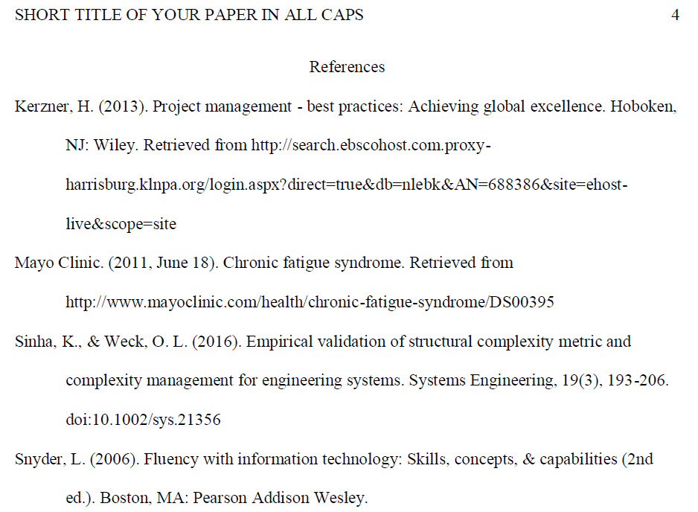

Slide 44

Questions?
Notes:
Are there any questions?

Slide 45
Contact the Library
Phone: (717) 901-5188
Email: Library@HarrisburgU.edu
Librarians on duty:
Monday – Friday: 7:30 AM – 5:00 PM
Library Website: http://library.harrisburgu.edu/home/discover
Library APA Guide: http://library.harrisburgu.edu/apa

